Slide 1


TURING 7 PROJECT
PROJECT OVERVIEW

Slide 2
OBJECTIVES
The objective of this project is to design and develop a replicate website for Kal Tire branch in Ghana, providing an online platform for customers to explore products, services, and innovations, and to facilitate online transactions and deliveries. The primary goal is to create a user-friendly and efficient website that meets the needs of Kal Tire's customers and stakeholders.

Slide 3
PROBLEM DOMAIN
The problem domain for this project is the lack of an online presence for Kal Tire's Ghana branch, making it difficult for customers to access information and services remotely. The website aims to bridge this gap by providing a digital platform for customers to interact with the company.

Slide 4
USERS AND REQUIREMENTS
USERS
PRIMARY REQUIREMENTS
PRIMARY FUNCTIONAL REQUIREMENTS
PRIMARY NON-FUNCTIONAL REQUIREMENTS

Slide 5

USERS
Customers: Individuals and businesses seeking information on Kal Tire's products and services, and wanting to make online transactions and deliveries.
Admin: Kal Tire's staff responsible for managing the website, updating content, and processing online transactions.

Slide 6
PRIMARY REQUIREMENTS
Develop a user-friendly and responsive website that showcases Kal Tire's products, services, and innovations.
Implement a search tool to facilitate easy navigation and product discovery.
Integrate a delivery button to enable customers to request delivery of products.
Develop a cart system to enable customers to add and remove products.
Create an admin dashboard for managing website content, processing online transactions, and tracking deliveries.

Slide 7
PRIMARY FUNCTIONAL REQUIREMENTS
The website shall display Kal Tire's products, services, and innovations in a user-friendly and organized manner.
The search tool shall enable customers to search for products by keyword, category, or brand.
The delivery button shall allow customers to request delivery of products to their preferred location.
The cart system shall enable customers to add and remove products, and calculate the total cost of the order.
The admin dashboard shall provide a user-friendly interface for managing website content, processing online transactions, and tracking deliveries.

Slide 8

Primary non-functional requirement
The website shall have a response time of less than 3 seconds for all pages and transactions.
The website shall be compatible with all modern browsers and devices.
The website shall ensure the security and integrity of customer data and transactions.
The website shall be scalable to handle a minimum of 1000 concurrent users.
This phase has been agreed to be implemented latter after the SWE(Software Engineering) project because the time frame would not permit that.

Slide 9
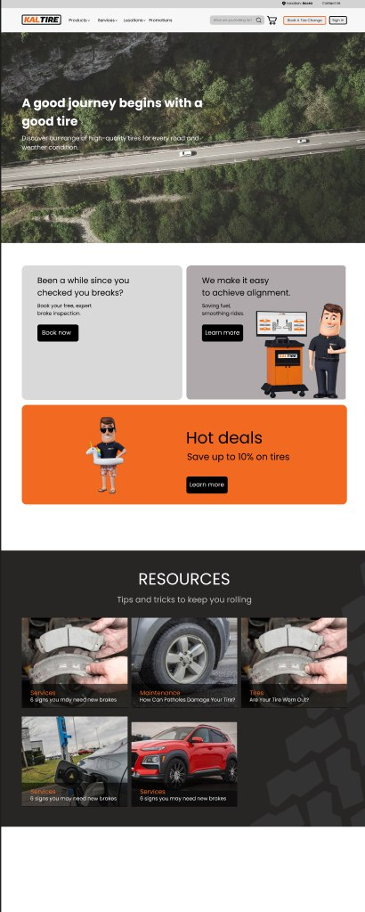
PRODUCT BLACKLOG
Develop the website's homepage and navigation menu
Implement the search tool and product filtering system
Design and develop the product pages and details
Integrate the delivery button and cart system
Develop the admin dashboard and content management system
Conduct testing and quality assurance

Slide 10
Product backlog
PHASE ONE (INITIAL LAUNCH)
PHASE TWO (ENHANCEMENT)

Slide 11

PHASE ONE(INITIAL LAUNCH)
Develop website structure and layout.
Implement product catalog and search functionality.
Integrate basic services section and regional information.
Set up secure payment gateway and delivery option

Slide 12
PHASE TWO(ENHANCEMENT)
Enhance user interface for improved usability.
Implement advanced search capabilities and personalized recommendations.
Integrate CRM for customer relationship management.
Expand innovation showcase with multimedia content.

Slide 13

Sprint planning
Divide the project into smaller tasks and assign them to team members based on expertise and workload.
Set realistic deadlines for each task and sprint, with regular check-ins and progress updates.
Prioritize tasks based on importance and complexity, and allocate resources accordingly.
Conduct regular code reviews and testing to ensure quality and consistency.

Slide 14
SPRINT PLANNING STRATEGIES
Sprint Duration: Two-week sprints to ensure regular progress and timely feedback.
Task Allocation: Assign tasks based on team members' expertise and availability.
Daily Standups: Brief daily meetings to discuss progress, challenges, and next steps.
Sprint Reviews: Review each sprint's deliverables with stakeholders to gather feedback and adjust priorities if necessary.
Retrospectives: Reflect on each sprint to identify successes and areas for improvement in processes and collaboration.

Slide 15

LESSONS LEARNED
CLIENT INTERACTION
Lesson: Clear communication of project milestones and expectations is crucial.
Action: Implement regular status updates and demos to align with client expectations.
TEAM WORK
Lesson: Collaboration and knowledge sharing enhance project outcomes.
Action: Foster a culture of open communication and peer learning within the team.

Slide 16

CLIENT INTERACTION
Clearly communicate the project objectives and requirements to the client, and ensure their expectations are met.
Set up regular meetings and progress updates to ensure the client is informed and involved throughout the project.
Be flexible and adaptable to changes in the client's requirements and expectations.

Slide 17
TEAM WORK
Foster open communication and collaboration among team members to ensure a cohesive and efficient workflow.
Encourage team members to share their expertise and knowledge to improve the overall quality of the project.
Recognize and reward individual contributions and achievements to motivate team members.

Slide 18

Team member contribution

Slide 19
Members contributions
Lesson: Recognize and leverage each team member's strengths.
Action: Ensure equitable distribution of tasks and encourage skill development.
Selinam(Front End Developer) and Gifty(Database Administrator): Led the development of the website's frontend and user interface.
Akpemada(Full Stack Developer): Designed and developed the search tool and product filtering system.
Alexander(Backend developer & UI/UX Designer): Implemented the delivery button and cart system, and integrated the payment gateway.
Gabriel( Dev Ops Engineer) and Angela(Tester and Quality Assurance): Developed the admin dashboard and content management system, and conducted testing and quality assurance.
Osborn(Scrum master): Provided project management and oversight, ensuring the project was completed on time and within budget.

